Slide 1

Cell Consortium Engineering
AI-4-EB

Slide 2
Timeline of project
31.01.2022: Grant starts
01.06.2022: Alex Fedorec starts
04.11.2022: Position advertised internally
17.11.2022: Position advertised externally
08.12.2022: Position advertisement closed
31.12.2022: Alex Fedorec leaves
13.01.2023: Interviews
15.02.2023: Pedro Fontanarrosa accepts position
15.06.2023: Pedro Fontanarrosa starts

Slide 3
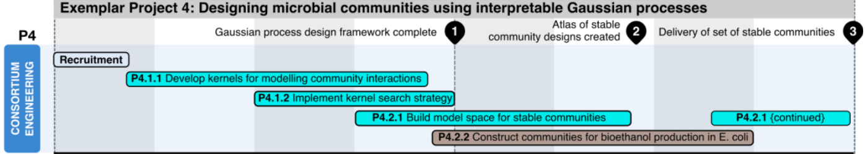
Objectives and deliverables
Objective 1: Develop the GP framework for interpretable dynamical system design.
Objective 2: Generate a library of stable microbial communities for bioethanol production.
PDRA time: 01.04.22 – 31.01.2024 (22 months)

Slide 4
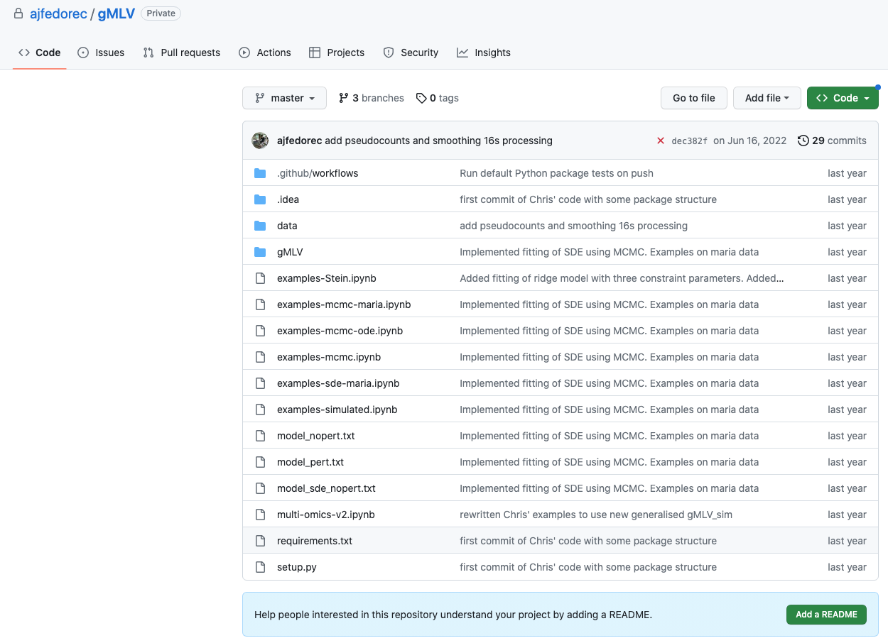
Progress / outputs
Software package: gMLV
Simulation and inference methods for microbial communities

Slide 5
Challenges
Alex moving to a permanent position
Hiring into the project
Budget: £68,950 left for salary
33% funds used for 6 months work (27% of 22 months)
Challenges with the methodology
Plan is for Pedro to sit with Marc in CS for fraction of the week

Slide 6
Additional slides

Slide 7
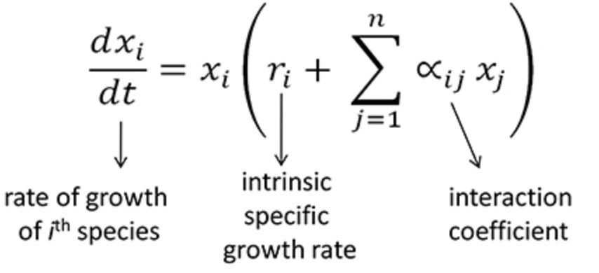
Cell Consortium Engineering
x1
x2
x3
We are interested in p( x3 | x1, x2, theta )

Slide 8
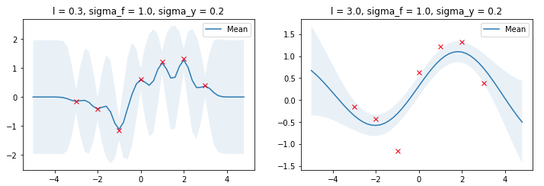
What is a Gaussian process?
The parameters of the covariance function define how a function can vary over input space

Slide 9
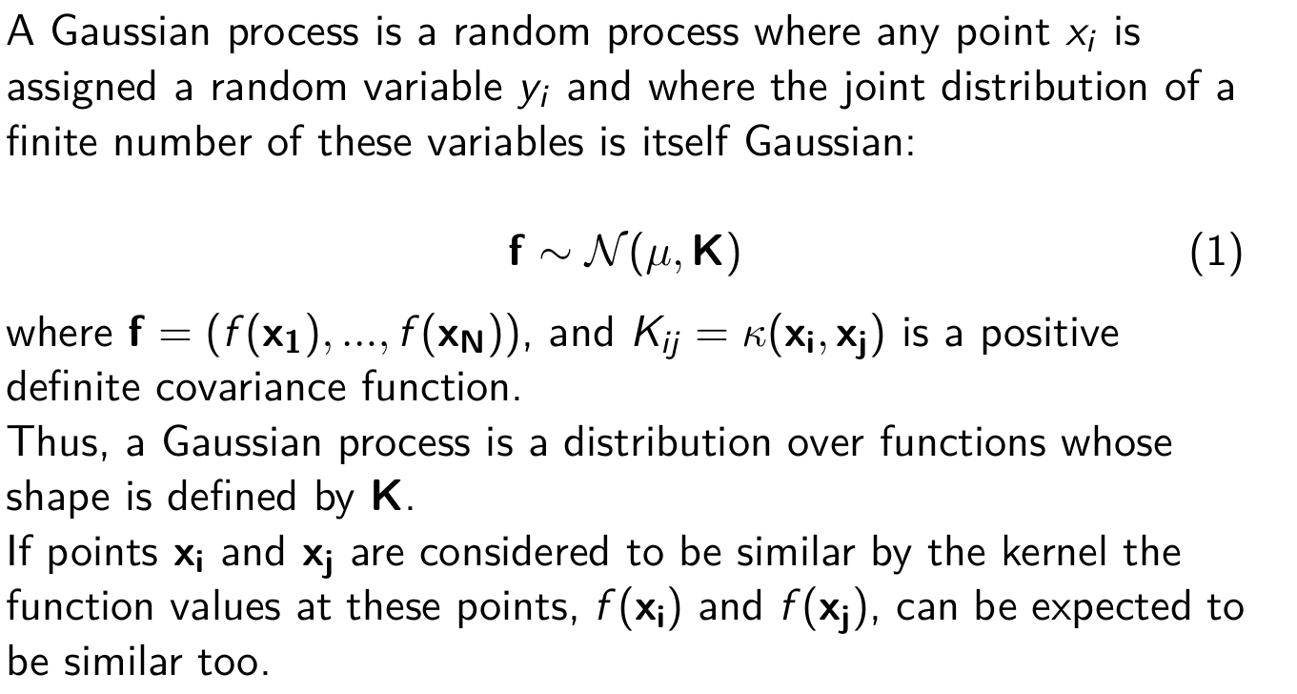
What is a Gaussian process?

Slide 10
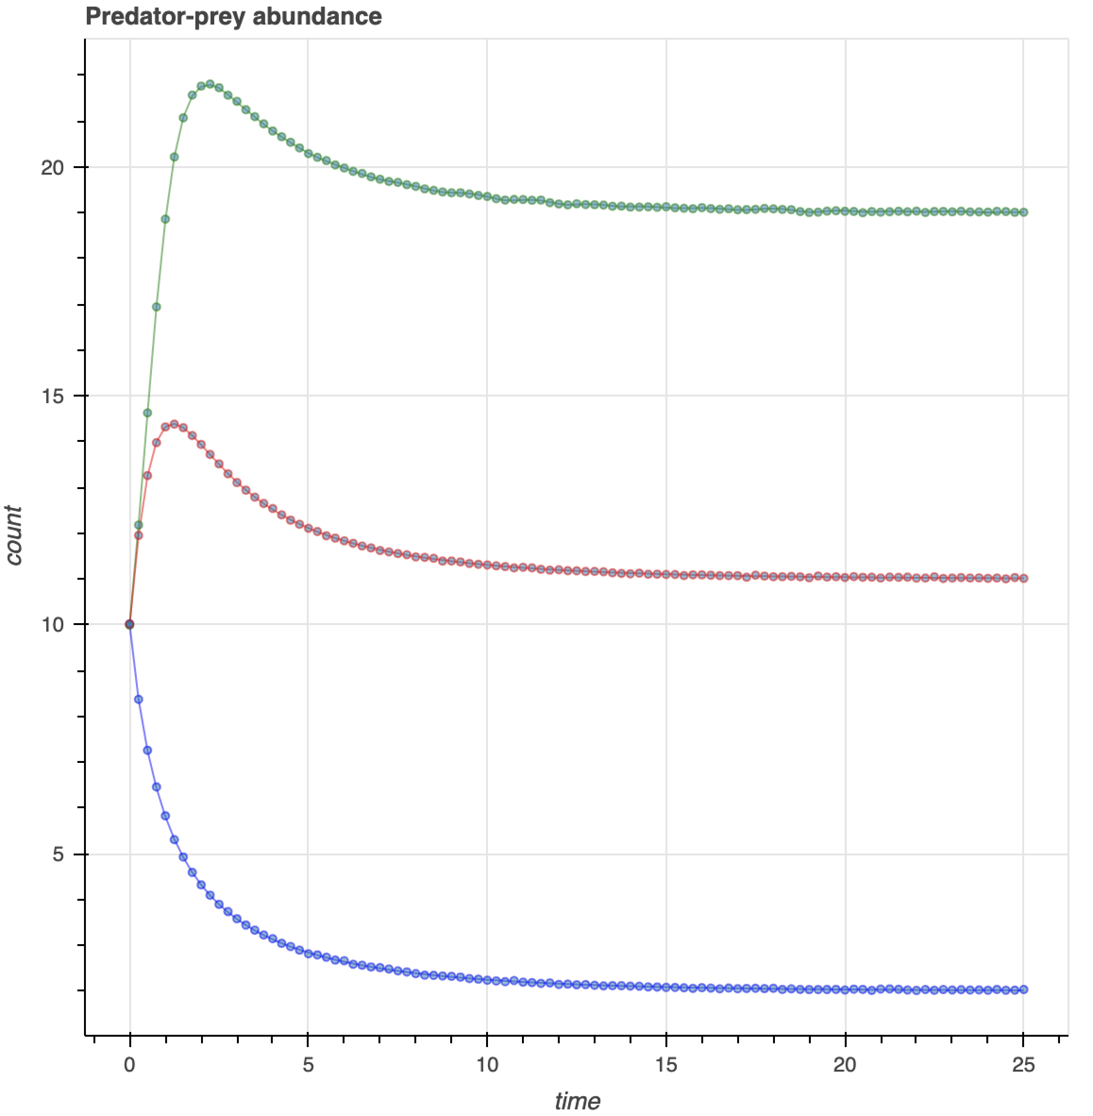
Lotka-Volterra type dynamics

Slide 11
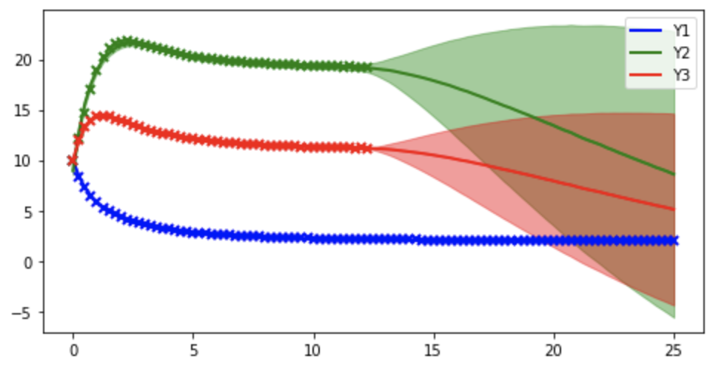
Multi-output Gaussian processes using GPflow

Slide 12
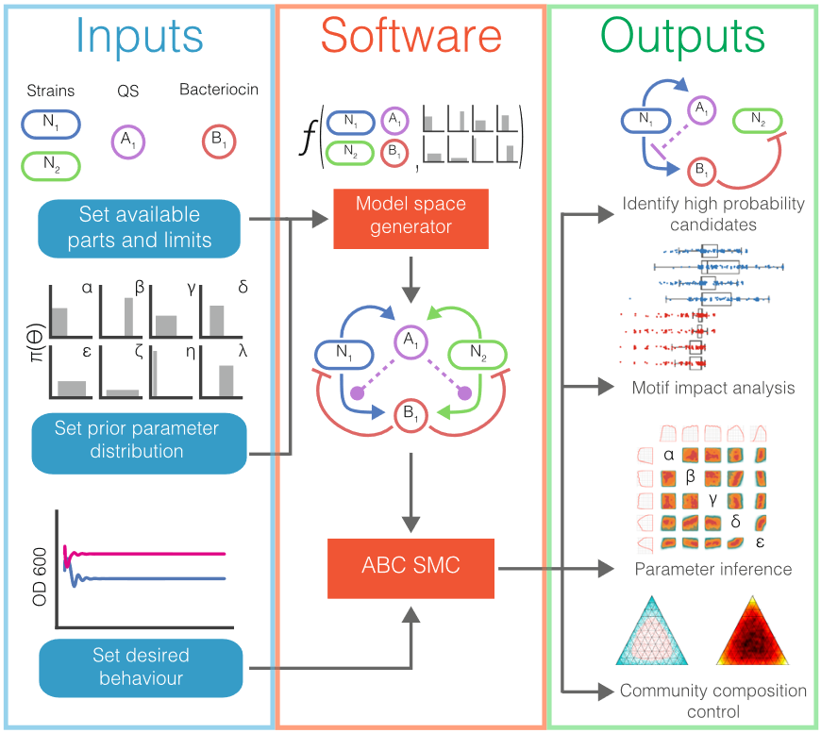
Design based on Approximate Bayesian Computation
Karkaria et. al. Nat Commun (2021)

Slide 13
Why use Gaussian Processes for design?
Approximate Bayesian Computation
computationally expensive
does not scale well
explicitly interpretable
Gaussian processes
much more general
non-parametric
should be able to be applied to much larger communities
interpretation
lack of biological rigidity

Slide 14
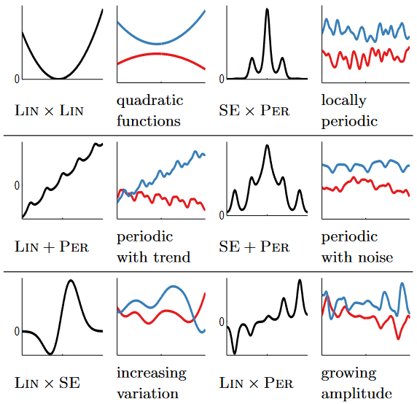
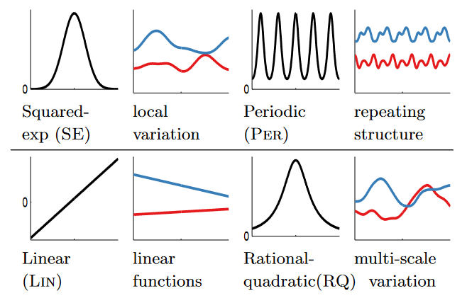
Interpretable kernels
Composition to produce more complex functions
Set of simple interpretable kernels
Duvenaud et al., 2013
Lloyd et al., 2014

Slide 15
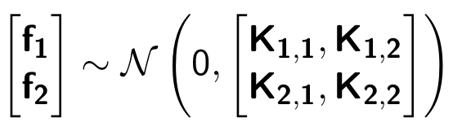

Sampling kernels
Sampling will involve exploring kernel space
x1
x2

Slide 16
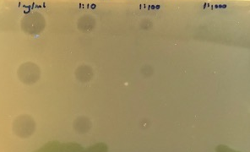
Biological implementation
We have been:
Building a library of inter-cellular toxins to produce negative interactions between species

Slide 17
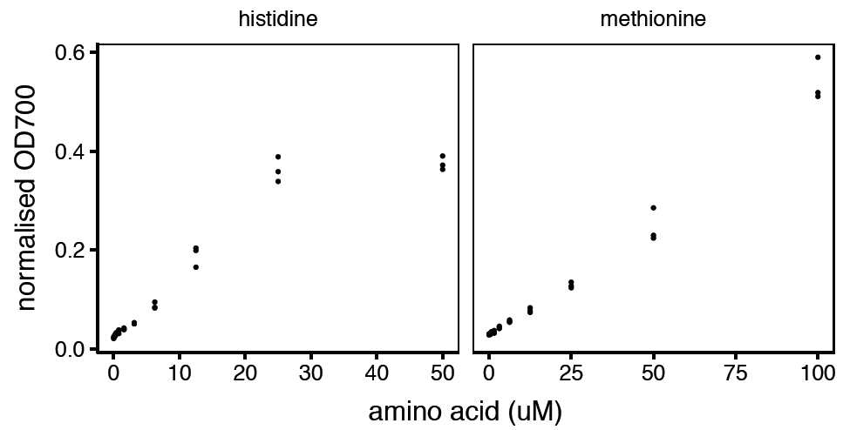
Biological implementation
We have been:
Characterising auxotrophic strains to enable cross-feeding positive interactions between species

Slide 18
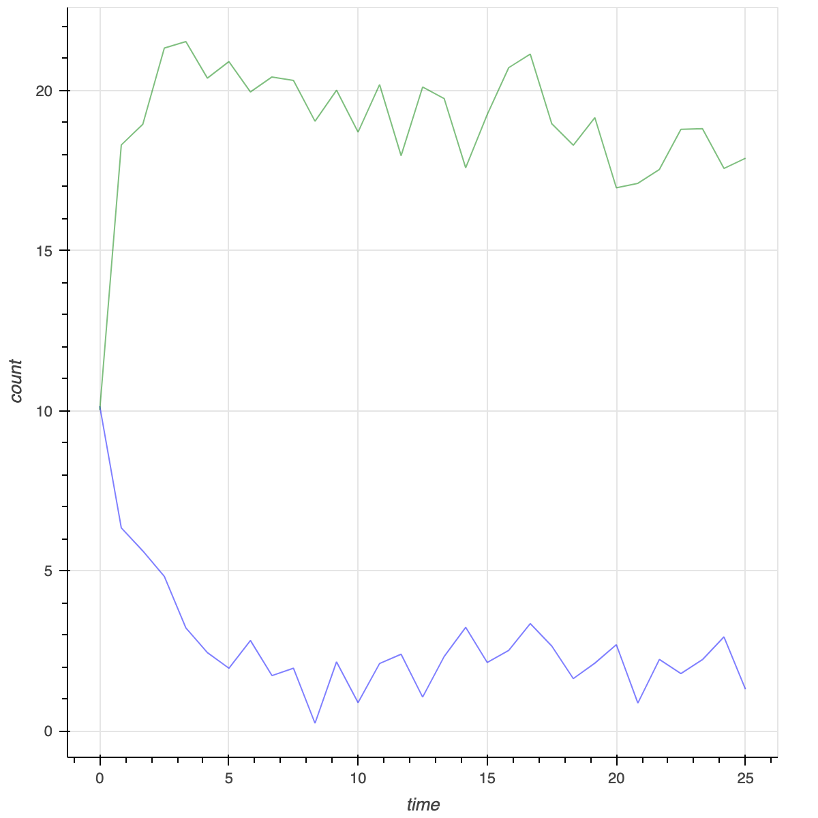
s1, s2

Slide 20
Biological implementation
We have been:
Building a library of inter-cellular toxins to produce negative interactions between species
Characterising auxotrophic strains to enable cross-feeding positive interactions between species
Building communication modules with quorum sensing systems

Slide 21
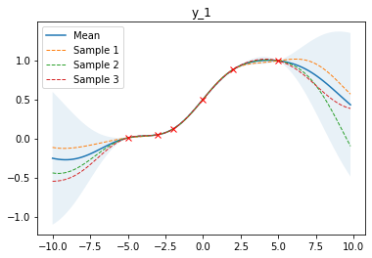
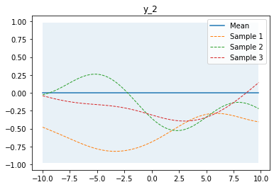
Example: two species community
If species f1 behaves as below
x1
x2
If K_{1,2} is 0, f1 has no correlation with f2
Design come down to conditional:
f2 | f1, t1, t2

Slide 22
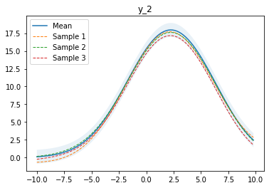
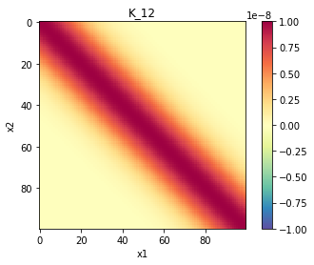
Example: two species community
If species f1 behaves as below
x1
x2
If K_{1,2} is a positive kernel
Design come down to conditional:
f2 | f1, t1, t2

Slide 23
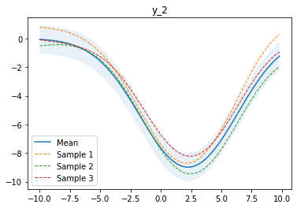
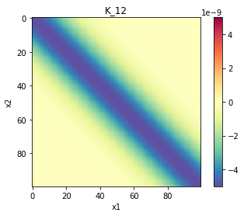
Example: two species community
If species f1 behaves as below
x1
x2
If K_{1,2} is a negative kernel

Slide 24
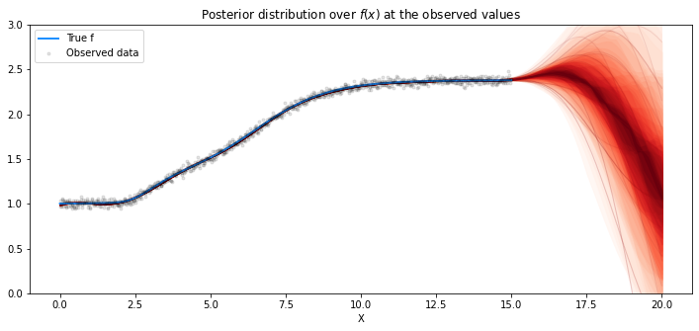
Fitting complex growth behaviour
Reproducing Swain et al.
Complex growth modelled as linear sum of Gompertz and Richards models
Squared exponential kernel

Slide 25
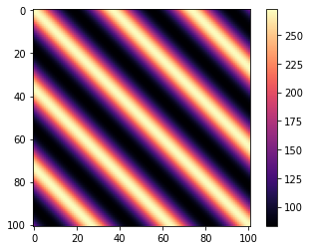
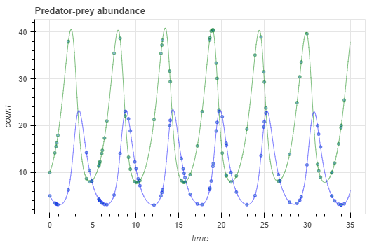
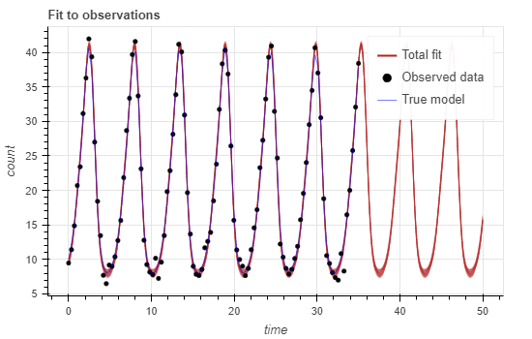
Fitting to periodic observations
Lotka-Volterra model
Using a periodic kernel
Can fit single output
x1
x2

